Slide 1
FRAMING & ERROR CONTROL

Slide 2
Frames
Data link layer receives the data from the network layer and divide it into manageable units called frames
Frames are the small data units created by the data link layer and the process of creating frames by the data link layer is called framing
Each frame has a frame header, a payload field for holding the packet, and a frame trailer.

Slide 3
It then computes the checksum for each frame ands it to the frame. Checksum provide the error correction mechanism
On the destination side, data link layer receives these frames from the physical layer and recomputed the checksum for each frame.
If this newly computes checksum is different from the one contained in the frame, then data link layer knows that an error has occurred.
Data link layer then discards this erroneous frame asks for retransmission.

Slide 4
Framing Methods
Character count
Starting and ending characters with character stuffing.
Starting and ending flags with bit stuffing.
Physical layer coding violations.

Slide 5
Character Count
Character Count method specifies the number of characters that are present in the particular frame.
This information is specified in the header field of the frame.
When the data link layer at the destination sees the character count ,it comes to know how many characters are present in the frame. with this information it is able to detect the end of the frame.
The major problem with this method is that the character count can be changed due to an error during transmission. in such a situation destination will get out of synchronization.

Slide 6
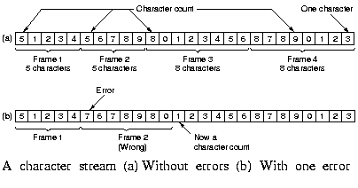

Slide 7
Starting and Ending Characters with Character Stuffing
In this methos,each frame starts ands with special character that mark the start and end of the frame.
Each frame begins and ends with a ASCII character sequence DLE STX(data link escape start of text) and ends with ASCII character sequence DLE ETX(data link escape end of text).
With the ASCII sequence character the problem of resynchronization after an error which is prominent is character is solved.
Even if the destination loses the track of frame boundries,the problem can be solved by looking for DLE STX or DLE ETX to start with new frame.

Slide 8
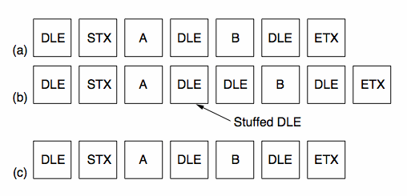

Slide 9
The major problem can arise in this method when DLE STX or DLE ETX occurs as data. In this case these characters that are present as data may be misinterpreted as start or end of frame,
To handle this problem a technique called character stuffing is used. in character stuffing, the data link layer on sender side adds an ASCII DLE character just before each DLE character as data.
On receiver side, data link layer will remove this additional DLE character that was stuffed by sender’s data link & will pass this data to network layer.
The major disadvantage is that it uses 8 bit character and ASCII code. It does not allow the arbitrary sized characters.

Slide 10
Starting and Ending Flags with Bit Stuffing
In this method each frame begins and ends with a special bit pattern 01111110 called flag byte.
Therefore each frame starts with 01111110 and with 01111110.
The main advantage of this method is that it allow data frame with arbitrary number of bits and also allow character code with an arbitrary number of bits per character.
The problem arise when the 01111110 flag byte appears as data.
This problem is handled by the technique called bit stuffing.

Slide 11
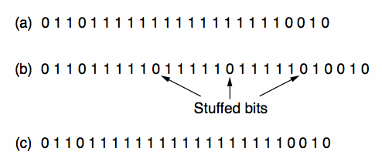

Slide 12
Whenever the sender data link detects the five consecutive ones in the data, it automatically stuffs a 0 bit into the outgoing bit stream. this is known as bit stuffing.
Whenever the receiver sees five consecutive ones in the bit stream, it automatically removes the 0 bit.

Slide 13
Error Control
Error control function of data link layer detects the error in the transmitted frames & retransmit all the erroneous frames.
Error control functions is dealing with data frames that are damaged in transmisssion,data frame lost in transmit acknowledgement frames that are lost in transmission.
The method used for error control is Automatic Repeat Request(ARQ).

Slide 14
AUTOMATIC REPEAT REQUEST(ARQ).
If an error is detected in any frame, the receiver sends a negative acknowledgement (NAK) back to source and the specified frame is retransmitted.
This process is known as Automatic Repeat Request(ARQ).
ARQ helps in dealing with :
Damaged data frames
Lost data frame
Lost acknowledgment frames(both ACK &NAK).

Slide 15
Damaged data frame
If a data frame received by receiver contains an error, it returns a NAK frame to the sender.
On receiving NAK frame, sender retransmits the last data frame.
E.g. sender sends a data frame data0 to the receiver.th receiver returns an ACK 1.
The sender then transmits next data frame dta1 and receiver sends ACK0.these data and ACK frames are alternatively numbered 0 &1.
The sender then transmits next frame data0.the receiver finds an error in it & sends a NAK to sender.

Slide 16
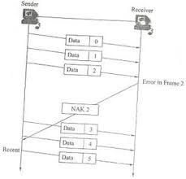
On receiving NAK.the sender retransmits data0 .
When data 0 is received correctly, the receiver sends back ACK1.

Slide 17
Lost Data Frame
Every sending device is equipped with a timer
The sender starts this timer when it transmits data frame
If a data frame is lost on its ways it will not be received by receiver. As a result the receiver can never acknowledge it, positively or negatively
The sending device waits for an ACK or NAK frame until timer goes off
If the acknowledgment is not received within specified time, the sender retransmits the last data frame, restarts its time and waits for an acknowledgment.

Slide 18
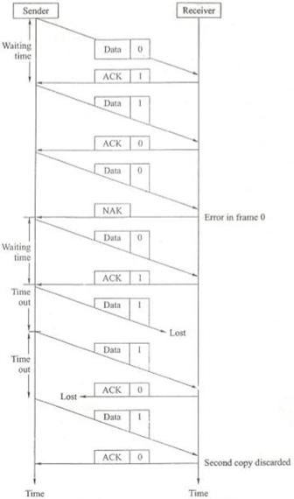

Slide 19
For e.g. the source sends data frame0,the receiver acknowledges it with ACK frame1.the source then transmits data frame1.this frame is lost on its way. after some time the timer goes out& the source transmits the data frame1 again.

Slide 20
Lost Acknowledgment Frame
When any data frame reaches the destination, the receiver acknowledges it either with ACK or with NAK.
If ACK or NAK frame returned by the receiver is lost in the transit,sendinig device retransmits the data frame that has not been acknowledged.
The sending device sets a timer every time when it transmits data frame, if ACK or NAK is not received by the source within the specified time, the timer goes off & the source retransmits that particular frame.

Slide 21
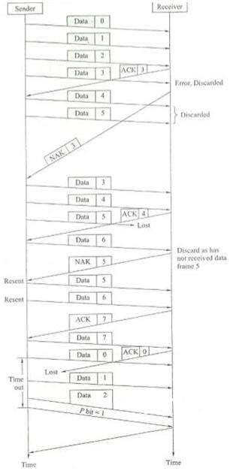

Slide 22
The receiver checks the number of the new data frame. If the lost frame was a NAK the receiver accepts the new copy and returns the appropriate ACK.
If the lost frame was an ACK the receiver recognized the new copy as a duplicate acknowledges its receipts then discards it waits for the next frame.

